Slide 1
An Alternative Certification Examination 'ACE' to assess the domains of professional practice

Slide 2
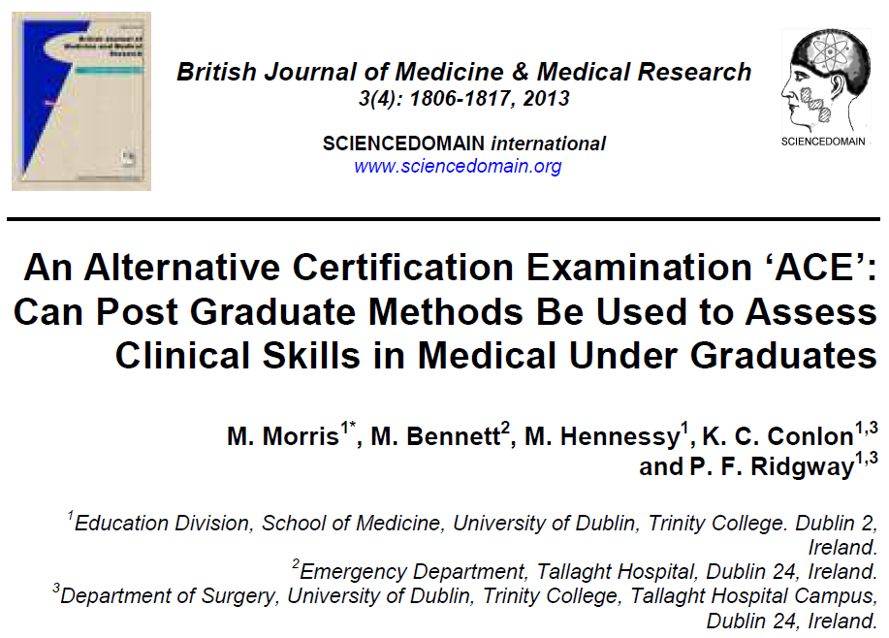

Slide 3
WHY INNOVATIVE ?
Medical graduates are required to be competent in many domains of professional practice.
Current undergraduate examination methods assess up to five of these eight required skills.
This study sought to evaluate an alternative format to assessing all eight of the required domains.

Slide 5
METHODS
143 medical students were invited to participate in an "ACE" .
137 students agreed to participate - 95.8% of the class.
The "ACE" format consisted of 4 sequential patient encounters observed by two independent examiners.
Examiners and students evaluated this exam format using a Likert scale and free text comments.

Slide 6
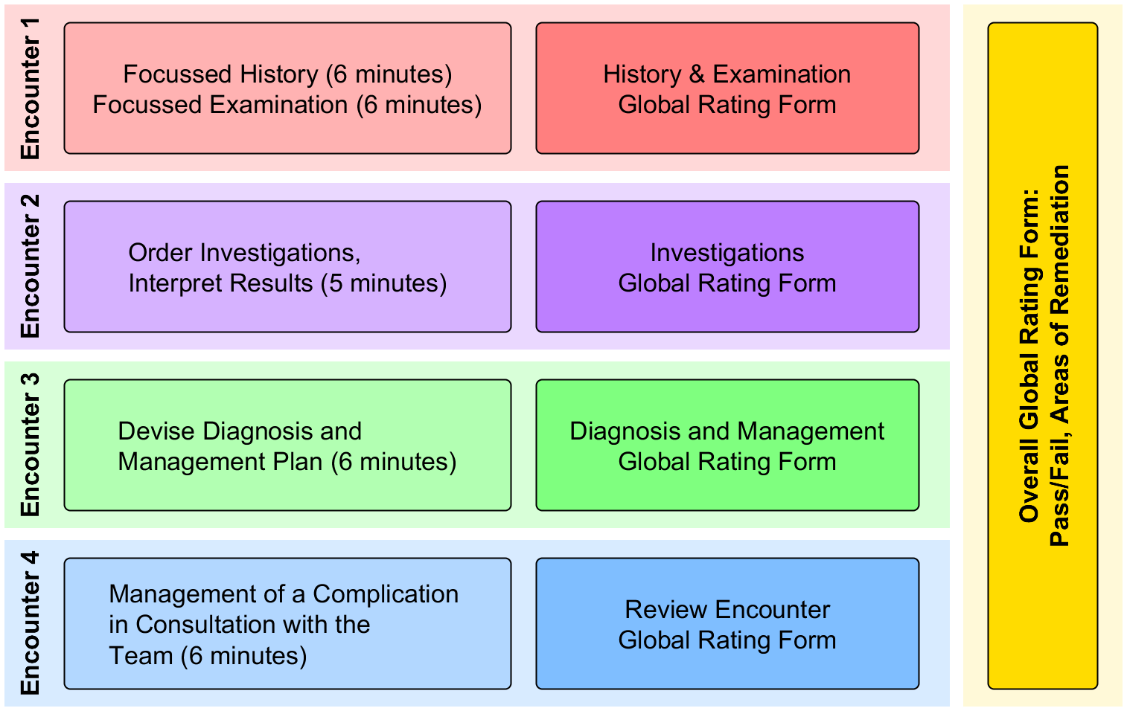
FORMAT

Slide 7
RESULTS
The "ACE" assessed all eight professional domains.
The correlation of grades between independent examiners in the "ACE" was strong at 0.907 (CI 0.766, 1) Cronbach`s Alpha.

Slide 8
RESULTS

Slide 9
RESULTS
Question | Statement | Percentile
 |  | Q1 | M | Q3
1 | ACE is a comprehensive exam format | 4 | 4 | 5
2 | Identifies strengths/weaknesses | 4 | 4 | 4
3 | ACE is a better exam method compared to OSCE | 4 | 4.5 | 5
4 | Examining a Total Patient Episode is better than an OSCE individual station approach | 4 | 4.5 | 5

Slide 10
RESULTS
“No where to hide”,
“Makes you manage the whole event“,
“Not just do a history or a cannula”,
“Gives you an idea of the intern role”,
“Could see immediately the students who had been on the wards”,
“Logistically much easier to run than an OSCE” .

Slide 11
FUTURE SUSTAINABILITY
A multi- disciplinary examination to evaluate this methodology further.
Investigation into how many cases are needed to ensure sensitivity and specificity.

Slide 12
POTENTIAL FOR USE ACROSS COLLEGE
Nursing
Physiotherapy
Speech and Language Therapy
Dietetics
Dentistry

Slide 13
CONTACT DETAILS
MARIE MORRIS MORRISM4@TCD.IE

Slide 14
Thank You

